Slide 1
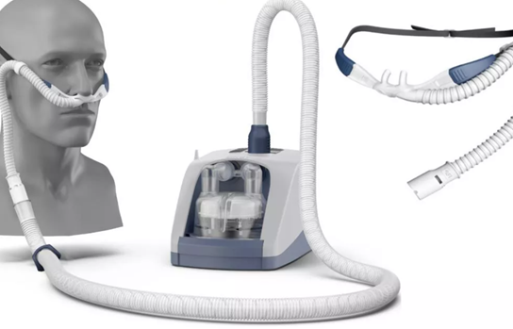
Transnasal Humidified Rapid-Insufflation Ventilatory Exchange (THRIVE) Use in Pediatric Populations
Anita Sarkar B.S., Lee Nguyen M.D., Abigail Smith M.D., Niroop Ravula M.D.
University of California Davis; Lucile Packard Children’s Hospital (Stanford University); Cincinnati Children’s Hospital; Lurie Children’s Hospital; University of Virginia Children’s Hospital; Massachusetts Eye and Ear Infirmary; Boston Children’s Hospital
INTRODUCTION
HYPOTHESES CONT.
METHODS CONT.
EXCLUSION CRITERIA CONT.
Children undergoing microdirect laryngoscopy and bronchoscopy (MDLB) pose anesthetic challenges while providing a motionless surgical field without an endotracheal tube.
2. We hypothesize that participants receiving HFNC catheters will demonstrate statistically fewer desaturations over participants receiving SOC.
Lurie Children’s
University of Virginia Children’s
Massachusetts Eye and Ear Infirmary
Boston Children’s
SUBJECTS:
Six hundred children undergoing MDLB between two months and eighteen years of age will be identified from the operating room schedule by a coordinating anesthesiologist. The randomization ratio is 1:1.
INCLUSION CRITERIA:
Patients undergoing airway examinations or procedures with or without laryngoscopic suspension with the goal of maintaining spontaneous respiration
EXCLUSION CRITERIA:
Pregnant patients
Patients with history of congenital cyanotic disease or airway papillomatosis
Anatomic or surgical contraindications to HFNC placement
PROCEDURES INVOLVED
RESEARCH QUESTIONS
Preoperatively, the EMR will be searched to collect medical history and physiological data. The Masimo pulse oximeter will be used to observe baseline oxygen saturation and heart rate. The THRIVE system will be placed after induction of anesthesia and prior to the start of the procedure.
The anesthesia monitors will record into EPIC every three minutes. The study investigators will only gather the heart rate and oxygen saturation in two second intervals from the Masimo.
A study personnel will remain in the room throughout to procedure to record procedure times, method of oxygen delivery, and number of surgical interruptions. During interruptions, the observer will record what, if any, airway intervention occurred.
Can use of high flow nasal cannula (HFNC) result in reduced oxygen desaturations as measured by the oxygen desaturation index (ODI) as compared to standard of care (SOC)?
Does the use of HFNC during MDLB result in reduced number of oxygen desaturations below 90%?
Does the use of HFNC during MDLB result in reduced number of surgical interruptions?
High flow nasal cannula (HFNC) delivered using the Optiflow THRIVE system (Fisher & Paykel Healthcare, Irvine, CA, USA)
METHODS
STUDY DESIGN:
This is a prospective, randomized, multi-center, non-blinded study.
STUDY SETTING:
The study will take place at seven Children’s Hospitals within the United States:
UC Davis
Lucile Packard Children’s
Cincinnati Children’s
HYPOTHESES
We hypothesize that participants receiving HFNC will demonstrate statistically improved ODI over participants receiving SOC.
Participants receiving HFNC catheters will demon

